Slide 1
You can soon book
your appointments with our practice online, whenever and wherever suits you.

Slide 2
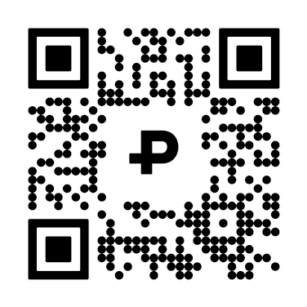
Save yourself some phone calls by:
1. Search for Pippo in your app store
2. Download the free app
3. Select this practice in the search menu
4. Complete the registration process
5. You will receive a text when your
registration is complete
6. Start booking your appointments* in
your Pippo app!
Flu and Covid bookings will initially be available to book online
Scan this code to download
the app now!

